Slide 1
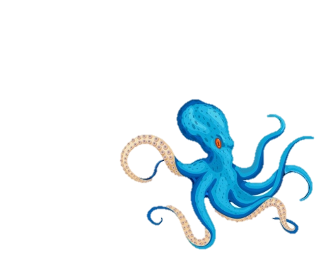
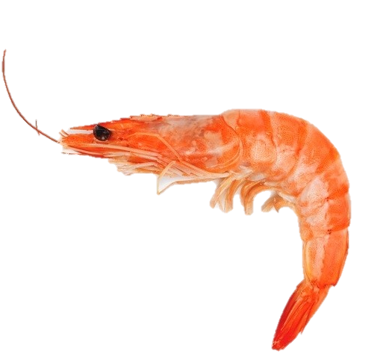
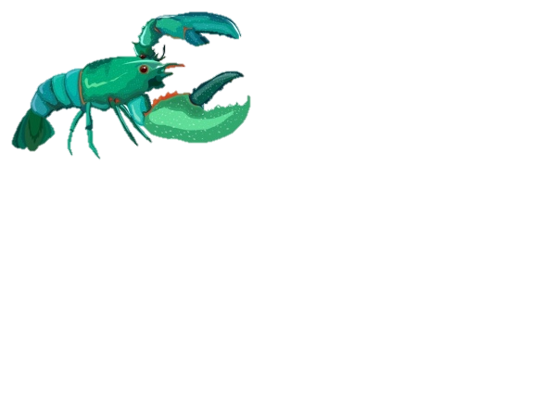
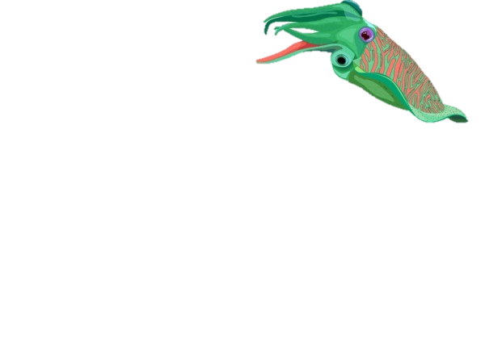
TRADEMARK M2020/00811
Authors:
Dumbravă Delia-Gabriela, Alexa Ersilia-Călina, Botău Dorica, Cocan Ileana, Dogaru Diana-Veronica, Drugă Mărioara, Mișcă Corina Dana, Moldovan Camelia, Negrea Monica,
Popa Viorica-Mirela, Raba Diana-Nicoleta, Rinovetz Alexandru Erne
BANAT’S UNIVERSITY OF AGRICULTURAL SCIENCES AND VETERINARY MEDICINE
”KING MICHAEL 1ST OF ROMANIA” FROM TIMIȘOARA
A range of innovative pate obtained from seafood, vegetable oils, natural spices and vegetables, in different assortments according to the manufacturing recipe. The products are both tasty and healthy, being rich in polyphenols, unsaturated fatty acids, quality proteins and having good antioxidant activity.
Seafood has long time been known for their nutritional properties and benefits to the human body when part of a healthy diet.
Seafood is rich in high quality protein, mineral elements, liposoluble vitamins (vitamins D, A, E), water-soluble vitamins (vitamin B6, niacin, vitamin B12, riboflavin, thiamin), carotenoids and essential fatty acids (especially long chain ω-3 and ω-6 poly-unsaturated fatty acids). Eicosapentaenoic acid (EPA) and docosahexaenoic acid (DHA) are the most important ω-3 fatty acids in seafood. These fatty acids are especially important for the health of the cardiovascular system.
Mussels meat is a rich source of omega 3 fatty acids and carotenoids (in particular beta carotene: 0.110-0.481 mg/100g and astaxanthin: 0.100-0.186 mg/100g).
Carotenoids are bioactive compounds with high antioxidant activity, particularly important for sight, skin protection and regeneration, but also for good functioning of the immune system. The mussels are high in protein, having a concentration of over 15% and low in cholesterol. The compounds with the greatest contribution to the antioxidant activity of mussels are polyphenols.
Calamari muscles are a source of high quality protein. They are easily digestible and contain all the essential amino acids.
The oil content of fresh calamari is 13±5%, where 29.40% are saturated fatty acids, 23.70% monounsaturated fatty acids and 40.20% polyunsaturated fatty acids. This oil is rich in EPA (9.60% of total fatty acids) and DHA (15.40%), and also in linoleic (5.20%), linolenic (3.10%), arachidonic (2.78%) acids.
Shrimps are an extremely good source of protein and have a low fat and calorie content, making it a healthy choice for consumers. In addition, shrimp meat contains unsaturated fatty acids, such as eicosapentaenoic acid (EPA) and docosahexaenoic acid (DHA), essential in the human diet. Shrimps are also a good source of vitamin B12, selenium and astaxanthin - a carotenoid compound with important antioxidant action.
Seafood pâté assortment | Seafood pâté with shrimps and red sweet peppers (P1) | Seafood pâté with mussels and calamari (P2)
Proteins (g) Total fat (g) - Saturated fat (g) Cholesterol (mg) Total carbohydrate (g) Dietary fiber (g) Sugar (g) Sodium (mg) | 9.10 21.89 2.02 69.79 3.03 0.76 1.30 389.10 | 9.56 24 2.44 20 16 5.56 0.13 350.81
Energy value (kcal) | 241.47 | 299.11
Total polyphenols (mg gallic acid/g) | 6.93±0.28 | 5.08±0.20
Antioxidant activity (mg Trolox/g) | 18.74±0.20 | 17.26±0.12
coresponding author: delia_dumbrava@yahoo.com

